Slide 1
Compression Program Report Part 2
Mohammed Imran

Slide 2
Task 2
For task 2 I need to develop a program that identifies word in the original sentence with the position of that word in that word in the list.
For example, the sentence
ASK NOT WHAT YOUR COUNTRY CAN DO FOR YOU ASK WHAT YOU CAN DO FOR YOUR COUNTRY
This only contains the words ASK, NOT, WHAT, YOUR, COUNTRY, CAN DO, FOR, YOU
The sentence can be recreated from the positions of the word in this list as:
1,2,3,4,5,6,7,8,9,1,3,6,7,8,4,5
Save the list of words and the positions of these words in the sentence as separate files or as a single file.

Slide 3
Analysis
For task 2 I need to develop a program that identifies word in the original sentence with the position of that word in that word in the list. This program will be slightly modified as it asks in the task to save all the positions into a list and save these positions into an external file.
For example, the sentence
ASK NOT WHAT YOUR COUNTRY CAN DO FOR YOU ASK WHAT YOU CAN DO FOR YOUR COUNTRY
This only contains the words ASK, NOT, WHAT, YOUR, COUNTRY, CAN DO, FOR, YOU
The sentence can be recreated from the positions of the word in this list as:
1,2,3,4,5,6,7,8,9,1,3,6,7,8,4,5
Save the list of words and the positions of these words in the sentence as separate files or as a single file.

Slide 4
Success Criteria
The code is successful when:
The program should work efficiently with no logical or syntax errors
The program should identify individual words in the sentence
The program should store these in a list with their positions
The program should label the same words with the same positions
It should also save the list as a single or as a separate files
The program should recreate the list
The program should allows the user to input a word
The program should store the word inputted a variable
The sentence should have no punctuation
The program should not be case sensitive so “ ask, Ask ASK” is the same word

Slide 5
Validation
A form of validation would be the if statement, this would prevents syntax and logical errors in the program. For example the program could have an if statement whether the word is in or not in the sentence and output something base which one is chosen. Another form of validation would be changing all words inputted into a lower case format, doing this makes sure that the program is not case-sensitive, this stop any errors occurring in the program. It should also prevent the program from allowing punctuation to be inputted, the program should remove all the punctuation for example if the words “hello,” and “hello” were inputted into the sentence, they will be treated as different word.
If I had more time I would validation I could use a form of length check, this will allow the program to only accept conventional sentence lengths and not paragraph. What I also could do is add a presence check to the program, this will make sure the user inputs something into the program and not leave it blank. A further validation type I could use is a spell check, to alert the user of incorrect spelling when the input into the program.

Slide 6
Programming Techniques
In this controlled assessment one of the programming techniques I am going to use variables which store values the user can input. The program should use inputs, so the user can enter values into a variable. It should also be able to output information, so the user can see information from the program. The program should use an if statement, so it can tell if a statement is true of false. The .split function, splits all words inputted into the sentence. The .lower function changes all words inputted into the sentence to a lower case format. The enumerate function gives a position to every single word in the sentence. The save function, saves what is in the variable to the text file, so the user can find the information calculated from the program in the file. The character limit stops the user from entering an abundant amount of words into the program, this is done to prevent the program from getting confused. The character limit limits how much you can input into the program to stop any logical errors.

Slide 7
Algorithm
START
While = true
Output “input a sentence”
Input sentence
Find duplicates in sentence
Label duplicate with x
Save the order in a list
Save list to computer
Output “input a word from the sentence”
Input word
Look for word in sentence
If word is in the sentence
Output word “is in the” x “position”
Else if word is not in sentence
Output “The Word you inputted isn’t in the sentence”

Slide 8
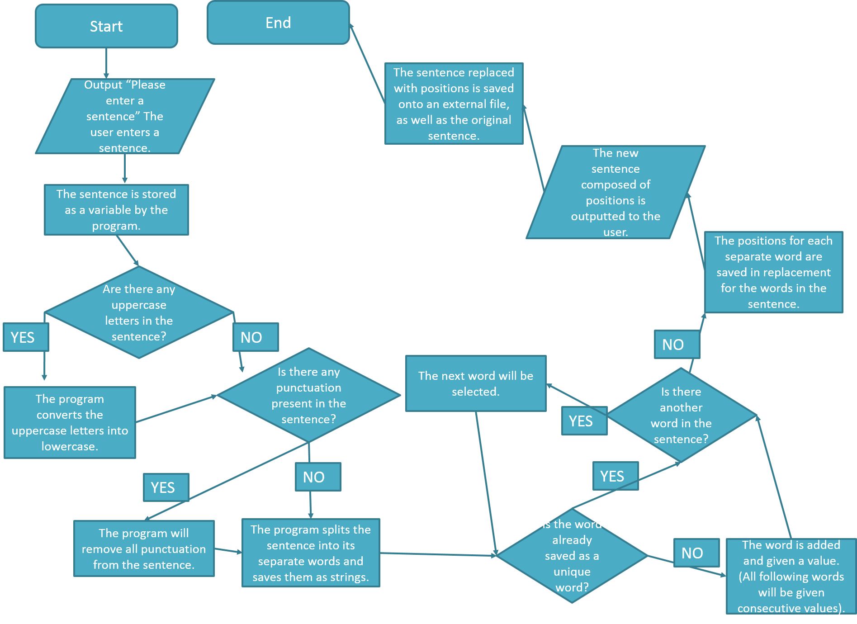
Flow Chart

Slide 9
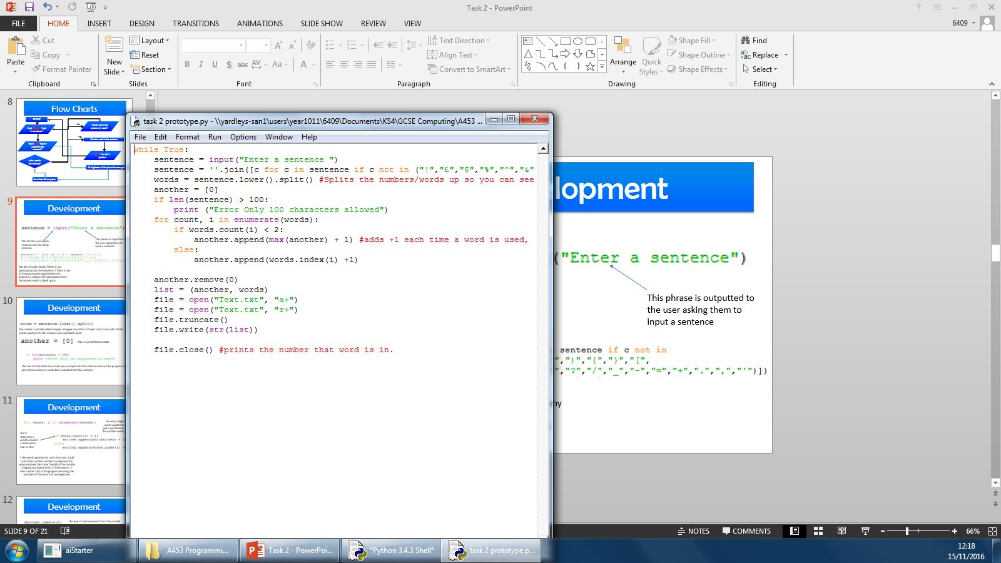
Development (Loop)
This while true loop puts the entire code on a loop. I chose to use and implement this so that it is more practical and easier to test and develop
The colon means the rest of the program will loop unless there is a break function in the program

Slide 10
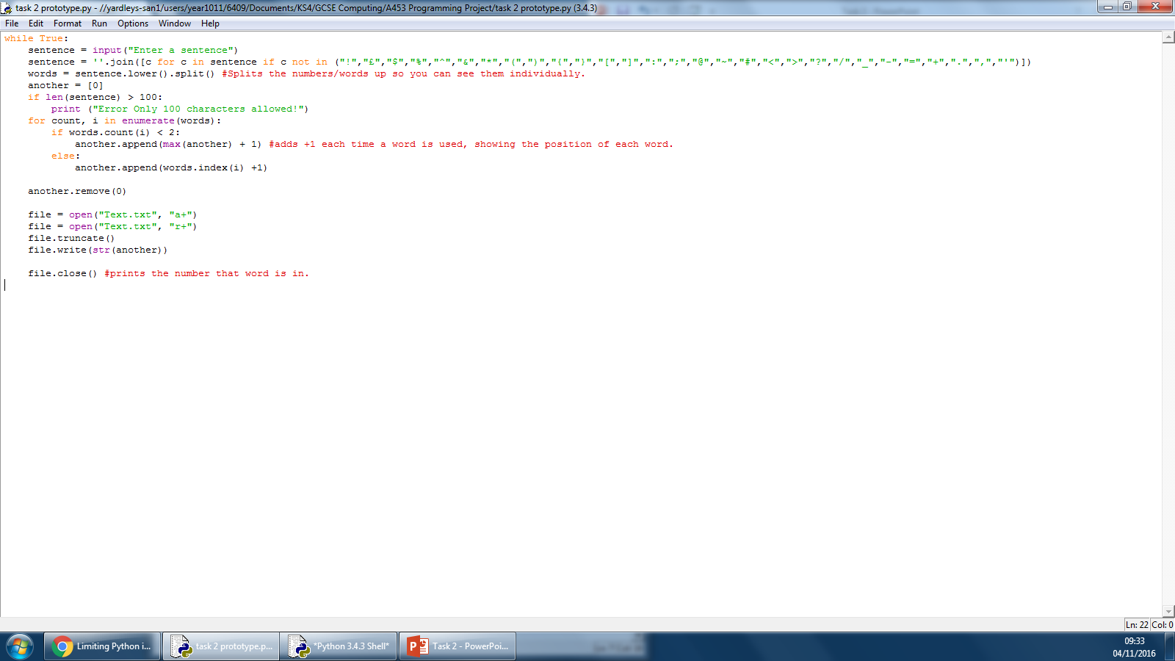
Development (Input)
The variable sentence stores whatever the user inputs
This phrase is outputted to the user asking them to input a sentence

Slide 11
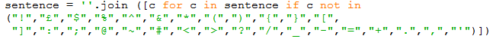
Development (Punctuation)
The .join function is to replace something with what is in the brackets
The line of code checks if there is any punctuation into the sentence. If there is any of the punctuation inputted into the program, it replaces the punctuation from the sentence with a blank space

Slide 12
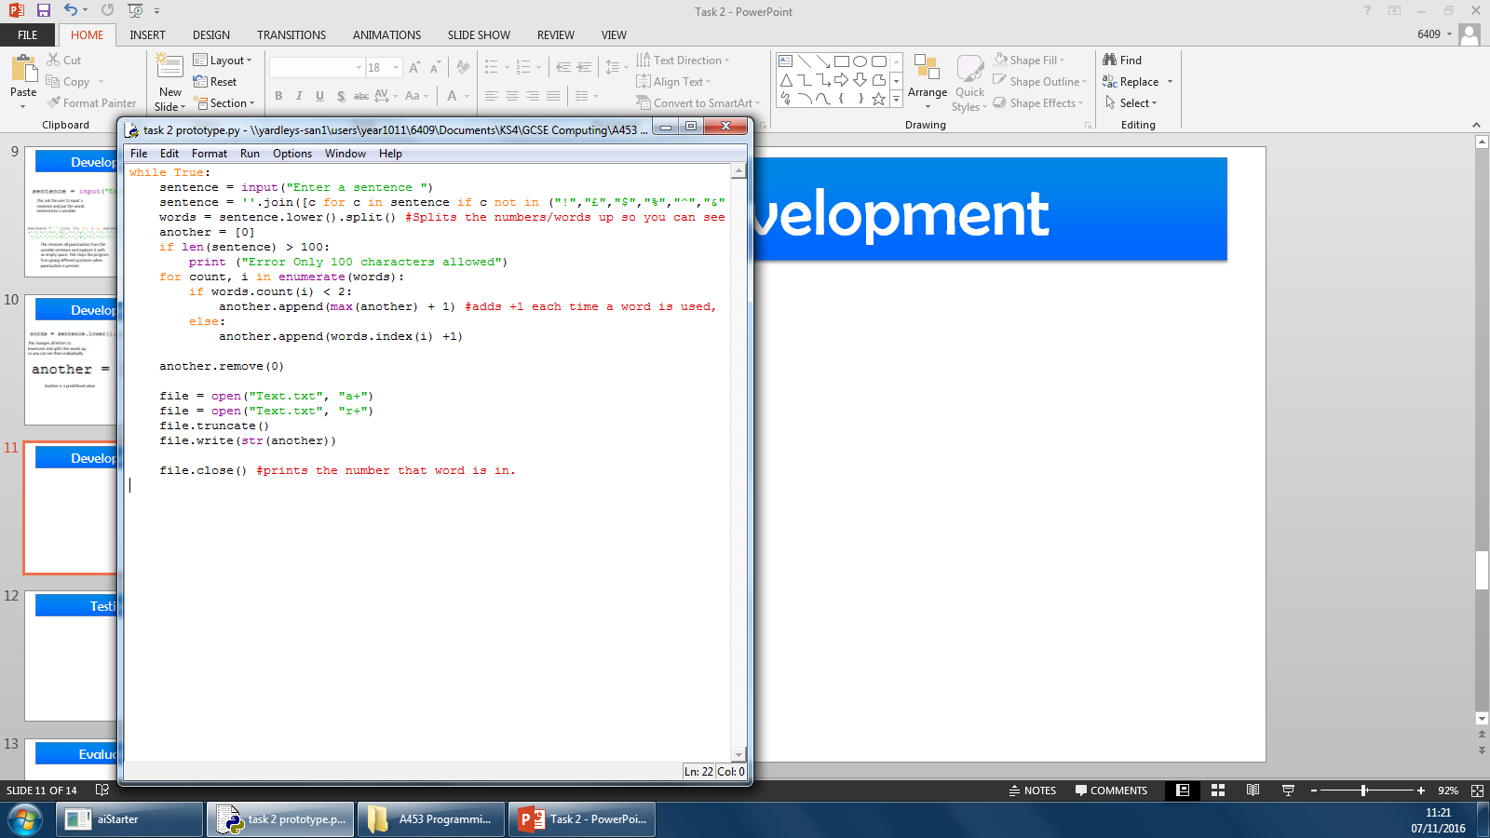
Development (List Creation)
This function gives every word in the variable a position.
For every word in the sentence add it in to the variable words

Slide 13
Development (List Creation)
The if statement is used to check whether if a statement is true or false
If the words inputted are more than one, it add one to the variable another to make sure the program knows the correct length of the variable stopping any logical errors in the program. It then creates a list in the program removing the positions of the word that are duplicates

Slide 14
Development (List manipulation)
This operator removes 0 from the variable another, so the list would not start with 0
If this not added the list begins with 0 not being as conventional as it could.

Slide 15
Development (Saving the file)
This is a variable which needs to open and close the file
This code creates a file named “text” in a text format. The “a+” lets the code be modified. The next code creates another text file that is only readable. This creates one that can be read and one that can be modified. It then removes already existing data. This stops the code from writing data over and over again.
The line of code writes whatever is in the string another into the text file. The next line of code saves and closes the text file in the same save location of the program

Slide 16
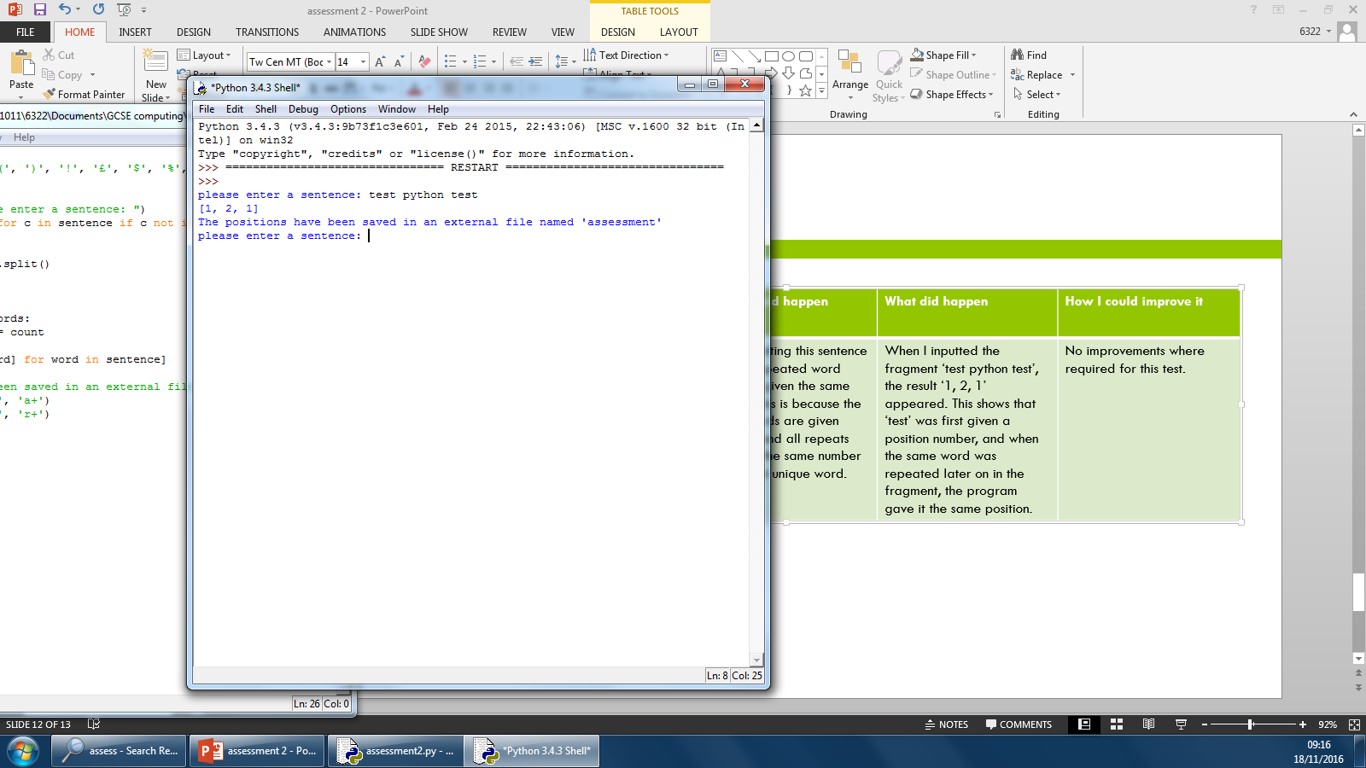
Testing (Identical Words)
Area to be tested | How to test this area | What should happen | What actually happened | Action taken
I will be testing if the program is given the same positions for the same words | Run the program in the RTE (Run-time-Environment). | The program should give the same positions to the same word | When the user inputs quite a lot of words into the sentence, it becomes difficult for the program to recognise the positions of the words | I fixed this error by using a character limit, so only conventional sentences can be inputted

Slide 17
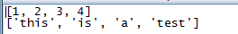
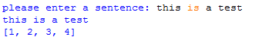
Testing (Saving the file)
Area to be tested | How to test this area | What should happen | What actually happened | Action taken
I will be testing if the program can save the file and can store data from the variable. | Run the program in the RTE (Run-time-Environment) and then check the files to see if it is in the files. | The program should save the file with the information from the list. | The program worked correctly and save the file in same place as the program | No action taken

Slide 18
Final Code
while True:
sentence = input("Enter a sentence ")
sentence = ''.join([c for c in sentence if c not in ("!","£","$","%","^","&","*","(",")","{","}","[","]",":",";","@","~","#","<",">","?","/","_","","=","+",".",",","'")])
words = sentence.lower().split() #Splits the numbers/words up so you can see them individually.
another = [0]
if len(sentence) > 100:
print ("Error Only 100 characters allowed")
for count, i in enumerate(words):
if words.count(i) < 2:
another.append(max(another) + 1) #adds +1 each time a word is used, showing the position of each word.
else:
another.append(words.index(i) +1)
another.remove(0)
list = (another, words)
file = open("Text.txt", "a+")
file = open("Text.txt", "r+")
file.truncate()
file.write(str(list))
file.close() #prints the number that word is in.

Slide 19
Evaluation
Task two of my A453 assessment is to develop and create a program which enables the user to input a sentence and creating a list which gives the same positions to the same words and save this list into a text file separate from the program. It also specified that the code would not be case sensitive.
In my success criteria it states that the program needs to function correctly with no syntax or logical errors in the program. I was successful in this part of the criteria as my program worked correctly and efficiently. This was the most challenging part of the success criteria as I came across a logical error. The logical was a problem as the program didn’t give the right list of positions in the text when too much values are entered into the sentence. I resolved this by creating a character limit inside the program.
The program should save variables into external files from the program. This part of the code was successful as the program did put the list into separate words. As an extension to this function the program clears the file when the program is used again so multiple lists won’t pile up. This was straight forward as the techniques used was basic variable manipulation. If I had more time I would make the program open the file after the program ends being more of a convenience to the user.
I stated in the criteria that the program should allows the user to input values and store them in variables, which can be received back to the user using outputs the inputs and outputs in my program works correctly. The inputs and outputs were already straight forward as I already know how they work.
The program shouldn’t be case sensitive to stop any errors, this is successful as the program puts whatever the user inputs into a lower case format. This was fairly simple as it is just one line of code that turns all the letters of that variable sentence to lower case.
My program should also remove the punctuation from the words inputted. This was fairly simple as the program replaces all the conventional punctuation with a blank space. This can be improved by removing all punctuation and not just the conventional punctuation.
The program should save a file with the list variable inside. I have exceeded success criteria in this area as it save the file with all the content inside while also saving the words inputted in the sentence. This was fairly simple as all I needed to do is create a file and store the variable inside.

Slide 20
Glossary
Variable - Something that stores information or data which can be modified
Operators - Used to change variables in the program
Inputs – What the user enters into the program
Outputs – What the computer presents from processing the inputs
Assignments – Another form of an operator which change variables
Sequence – A array stored in a variable in the program
Conditional – An if statement basing the out come from what is given
Iteration– Allow you to update variables in the program
Loops – When the program starts again after ending
Count Loops – When the program loops a certain amount of times
Boolean – Used in an if statement, these are operators basing things on actions e.g. and, or, not
String – Something that contains numbers like a variable
Arrays – A list in a variable
Logical Error – An error in which the program does not work as it was design but does not crash
Syntax Error – An error when there is faults in the code not letting the program run

